Slide 1
Input Tokenizers
Plaban Kumar Bhowmick
Department of AI
plaban@ai.iitkgp.ac.in

Slide 2
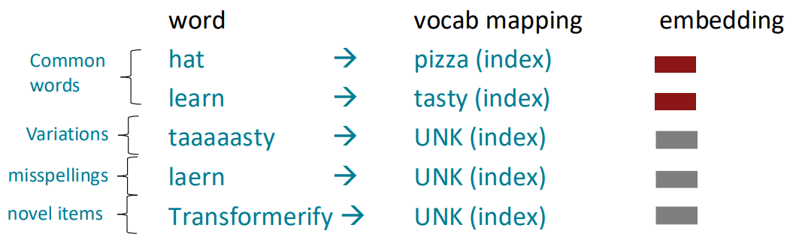
Input Tokens: Many Words are Rare
We assume a fixed vocab of tens of thousands of words, built from the training set.
All novel words seen at test time are mapped to a single [UNK]

Slide 3
Input Tokens: Sub-Word
The dominant modern paradigm is to learn a vocabulary of parts of words (subword tokens)
At training and testing time, each word is split into a sequence of known subwords
Byte-pair encoding
Common words end up being a part of the subword vocabulary
Rarer words are split into (sometimes intuitive, sometimes not) components.
In the worst case, words are split into as many subwords as they have characters.

Slide 4
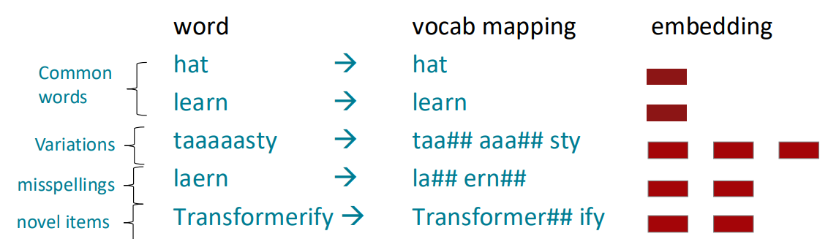
Input Tokens: Sub-Word

Slide 5
Tokenization Strategies
Commonly used tokenizers
Byte Pair Encoding (BPE) tokenizer
Wordpiece Tokenizer
SentencePiece Tokenizer
General steps
Step 1: Use a corpora to train the tokenizer (i.e., segmentation rules)
Step 2: Use the learned segmentation rules to tokenize any test input

Slide 6
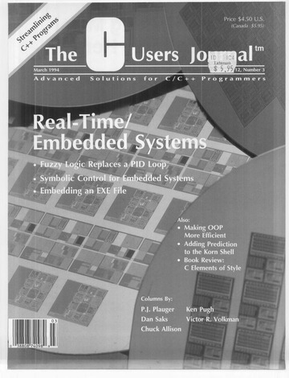
Byte Pair Encoding (BPE)
Philip Gage
Vocabulary
Symbol | Represents
a | a
b | b
c | c
d | d
aaabdaaabac
ZabdZabac
ZYdZYac
Z | aa
Y | ab
XdXac
X | ZY
A new algorithm for data compression

Slide 7
Byte Pair Encoding (BPE): Training
Tokenization
Pat pat cat sat on mat cat sat on mat with pat
Convert text to lowercase. Replace whitespace with a special symbol ␣
[pat␣], [pat␣], [cat␣], [sat␣], [on␣], [mat␣], [cat␣], [sat␣], [on␣], [mat␣], [with␣], [pat␣]
Tokenize at every character boundary. Build vocabulary with each unique character
INITIAL TOKENS:
[['p', 'a', 't', '␣'], ['p', 'a', 't', '␣'], ['c', 'a', 't', '␣'], ['s', 'a', 't', '␣'],
['o', 'n', '␣'], ['m', 'a', 't', '␣'], ['c', 'a', 't', '␣'], ['s', 'a', 't', '␣'],
['o', 'n', '␣'], ['m', 'a', 't', '␣'], ['w', 'i', 't', 'h', '␣'], ['p', 'a', 't', '␣']]
INITIAL VOCAB:
['a', 'c', 'h', 'i', 'm', 'n', 'o', 'p', 's', 't', 'w', '␣']

Slide 8
Byte Pair Encoding (BPE)
Token | Frequency
a | 9
c | 2
h | 1
i | 1
m | 2
n | 2
o | 2
p | 3
s | 2
w | 1
t | 10
␣ | 12
INITIAL TOKENS:
[['p', 'a', 't', '␣'], ['p', 'a', 't', '␣'], ['c', 'a', 't', '␣'], ['s', 'a', 't', '␣'],
['o', 'n', '␣'], ['m', 'a', 't', '␣'], ['c', 'a', 't', '␣'], ['s', 'a', 't', '␣'],
['o', 'n', '␣'], ['m', 'a', 't', '␣'], ['w', 'i', 't', 'h', '␣'], ['p', 'a', 't', '␣']]
INITIAL VOCAB:
['a', 'c', 'h', 'i', 'm', 'n', 'o', 'p', 's', 't', 'w', '␣']

Slide 9
Byte Pair Encoding (BPE): Training
Merge Operation
Merge 1
Token | Frequency
a | 9
c | 2
h | 1
i | 1
m | 2
n | 2
o | 2
p | 3
s | 2
w | 1
t | 10
␣ | 12
at | 9
TOKENS: [[p, a, t, ␣], [p, a, t, ␣], [c, a, t, ␣], [s, a, t, ␣], [o, n, ␣],
[m, a, t, ␣], [c, a, t, ␣], [s, a, t, ␣], [o, n, ␣],
[m, a, t, ␣], [w, i, t, h, ␣], [p, a, t, ␣]]
VOCAB: [a, c, h, i, m, n, o, p, s, t, w, ␣]
PAIRS: (p,a)=3 | (a,t)=9 | (t,␣)=9 | (c,a)=2 | (s,a)=2 | (o,n)=2 | (n,␣)=2 | (m,a)=2 | (w,i)=1 | (i,t)=1 | (t,h)=1 | (h,␣)=1
SORTED: (a,t)=9 | (t,␣)=9 | (p,a)=3 | (c,a)=2 | (s,a)=2 | (o,n)=2 | (n,␣)=2 | (m,a)=2 | (w,i)=1 | (i,t)=1 | (t,h)=1 | (h,␣)=1
MERGE: (a,t) → at
UPDATED TOKS: [[p, at, ␣], [p, at, ␣], [c, at, ␣], [s, at, ␣],
[o, n, ␣], [m, at, ␣], [c, at, ␣], [s, at, ␣],
[o, n, ␣], [m, at, ␣], [w, i, t, h, ␣], [p, at, ␣]]
UPDATED VOCAB: [a, c, c, h, i, m, n, o, p, s, t, w, ␣, at]
MERGE RULES: [(a,t) → at]

Slide 10
Byte Pair Encoding (BPE): Training
Merge 2
PAIRS: (p, at)=3 | (at, ␣)=9 | (c, at)=2 | (s, at)=2 | (o, n)=2 | (n, ␣)=2 | (m, at)=2 | (w, i)=1 |
(i, t)=1 | (t, h)=1 | (h, ␣)=1
SORTED: (at, ␣)=9 | (p, at)=3 | (c, at)=2 | (s, at)=2 | (o, n)=2 | (n, ␣)=2 | (m, at)=2 |
(w, i)=1 | (i, t)=1 | (t, h)=1 | (h, ␣)=1
MERGE: (at, ␣) → at␣
UPDATED TOKS: [[p, at␣], [p, at␣], [c, at␣], [s, at␣], [o, n, ␣], [m, at␣], [c, at␣], [s, at␣],
[o, n, ␣], [m, at␣], [w, i, t, h, ␣], [p, at␣]]
UPDATED VOCAB: [a, at, at␣, c, h, i, m, n, o, p, s, t, w, ␣]
MERGE RULES: [(a, t) → at, (at, ␣) → at␣]

Slide 11
Byte Pair Encoding (BPE): Training
Merge 3
PAIRS: (p, at␣)=3 | (c, at␣)=2 | (s, at␣)=2 | (o, n)=2 | (n, ␣)=2 | (m, at␣)=2 | (w, i)=1 | (i, t)=1 | (t, h)=1 | (h, ␣)=1
SORTED: (p, at␣)=3 | (c, at␣)=2 | (s, at␣)=2 | (o, n)=2 | (n, ␣)=2 | (m, at␣)=2 | (w, i)=1 | (i, t)=1 |
(t, h)=1 | (h, ␣)=1
MERGE: (p, at␣) → pat␣
UPDATED TOKS: [[pat␣], [c, at␣], [s, at␣], [o, n, ␣], [m, at␣], [c, at␣], [s, at␣], [o, n, ␣],
[m, at␣], [w, i, t, h, ␣], [pat␣]]
UPDATED VOCAB: [a, at, at␣, c, h, i, m, n, o, p, pat␣, s, t, w, ␣]
MERGE RULES: [(a, t) → at, (at, ␣) → at␣, (p, at␣) → pat␣]

Slide 12
Byte Pair Encoding (BPE): Training
Merge 12
MERGE RULES:
[(a, t) → at,
(at, ␣) → at␣,
(p, at␣) → pat␣,
(c, at␣) → cat␣,
(s, at␣) → sat␣,
(o, n) → on,
(on, ␣) → on␣,
(m, at␣) → mat␣,
(w, i) → wi,
(wi, t) → wit,
(wit, h) → with,
(with, ␣) → with␣]
PAIRS: (with, ␣)=1
SORTED: (with, ␣)=1
MERGE: (with, ␣) → with␣
UPDATED TOKS:
[[pat␣], [pat␣], [cat␣], [sat␣], [on␣], [mat␣], [cat␣], [sat␣], [on␣], [mat␣], [with␣], [pat␣]]
UPDATED VOCAB:
[a, at, at␣, c, cat␣, h, i, m, mat␣, n, o, on, on␣, p, pat␣, s, sat␣, t, w, wi, wit, with, with␣, ␣]

Slide 13
Byte Pair Encoding (BPE): Inference
UPDATED VOCAB:
[a, at, at␣, c, cat␣, h, i, m, mat␣, n, o, on, on␣, p, pat␣, s, sat␣, t, w, wi, wit, with, with␣, ␣]
MERGE RULES:
[(a, t) → at],
[(at, ␣) → at␣],
[(p, at␣) → pat␣],
[(c, at␣) → cat␣],
[(s, at␣) → sat␣],
[(o, n) → on],
[(on, ␣) → on␣],
[(m, at␣) → mat␣],
[(w, i) → wi],
[(wi, t) → wit],
[(wit, h) → with],
[(with, ␣) → with␣]
WORD: pat␣
TOKENS: [p, a, t, ␣]
PAIRS: (p, a) | (a, t) | (t, ␣)
MERGE 1: [p, at, ␣]
PAIRS: (p, at) | (at, ␣)
MERGE 2: [p, at␣]
PAIRS: (p, at␣)
MERGE 3: pat␣
WORD: patio␣
TOKENS: [p, a, t, i, o, ␣]
PAIRS: (p, a) | (a, t) |
(t, i) | (i,o) | (o, ␣)
MERGE 1: [p, at, i, o, ␣]
PAIRS: (p, at) | (at, i) | (i,o) |
(o, ␣)
TOK: [p, at, i, o, ␣]
WORD: paty␣
TOKENS: [p, a, t, y, ␣]
PAIRS: (p, a) | (a, t) |
(t, y) | (y, ␣)
MERGE 1: [p, at, y, ␣]
PAIRS: (p, at) | (at, y) |
(y, ␣)
TOK: [p, at, y, ␣]
TOK: [p, at, [UNK], ␣]
Why do we need ‘␣’ ?
estonia vs. highest
How do we get rid of [UNK]?
Byte-Level BPE (BBPE)

Slide 14





WordPiece Tokenizer
Similar algorithm as BPE
Scoring a pair during merge step is different
Token | Frequency
a | 9
c | 2
h | 1
i | 1
m | 2
n | 2
o | 2
p | 3
s | 2
w | 1
t | 10
␣ | 12
at | 9
$$score\left(a,b\right)=\frac{freq(ab)}{freq\left(a\right)∗freq(b)}$$
PAIRS: (p,a)=3 | (a,t)=9 | (t,␣)=9 | (c,a)=2 | (s,a)=2 | (o,n)=2 | (n,␣)=2 | (m,a)=2 | (w,i)=1 | (i,t)=1 | (t,h)=1 | (h,␣)=1
$$score\left(p,a\right)=\frac{freq(pa)}{freq\left(p\right)∗freq(a)}=\frac{3}{3∗9}=\frac{1}{9}$$
$$score\left(a,t\right)=\frac{freq(at)}{freq\left(a\right)∗freq(t)}=\frac{9}{9∗10}=\frac{1}{10}$$
$$score\left(c,a\right)=\frac{freq(2)}{freq\left(2\right)∗freq(9)}=\frac{9}{9∗10}=\frac{1}{9}$$
Hugging → ['Hugg', '##i', '##n', '##g']
$$score\left(w,i\right)=\frac{freq(wi)}{freq\left(w\right)∗freq(i)}=\frac{1}{1∗1}=1$$
https://huggingface.co/learn/llm-course/en/chapter6/6?fw=pt

Slide 15
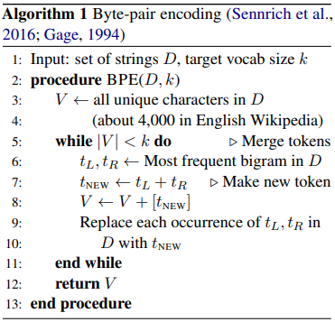
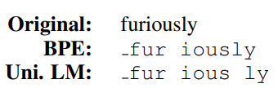

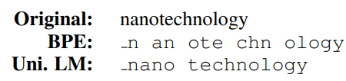

SentencePiece Tokenizer
BPE and WordPiece tokenizers follow greedy approach
Suboptimal tokenization
Quite often meaningless
The problem: BPE or WordPiece do not judge to what extent
the new vocabulary represents the training
corpora
Bostrom and Durrett, Byte Pair Encoding is Suboptimal for Language Model Pretraining

Slide 16
SentencePiece Tokenizer: Idea
Start with a large vocabulary
Repeat the reduction step
Remove some entries
Reduce the vocab
Check whether the reduced
vocabulary represents the
training data more appropriately
To what extent, does a vocabulary represent a given training data?

Slide 17


SentencePiece: Unigram Tokenizer
To what extent, does a vocabulary represent a given training data?
What is the likelihood of the training data given a vocabulary?
Probabilistic Language Model:
$$P\left(x_{1}, x_{2}, …., x_{N}\right)=P\left(x_{1}\right)×P\left(x_{2} | x_{1}\right)×P\left(x_{3} | x_{1}, x_{2}\right)×…×P\left(x_{N}\right|x_{1}, x_{2}, …,x_{N−1})$$
Unigram Language Model:
$$P\left(x_{1}, x_{2}, …., x_{N}\right)=P\left(x_{1}\right)×P(x_{2})×P(x_{3})×…×P(x_{N})$$
For a given sequence ${x=x}_{1}, x_{2}, …., x_{N}$:
$$P\left(x\right)=\prod_{i=1}^{N}{P(x_{i})} ∀_{i}x_{i}∈𝒱, \sum_{x∈𝒱}{P\left(x\right)=1}$$
Kudo, Subword Regularization: Improving Neural Network Translation Models with Multiple Subword Candidates (Section 3)
Chung, Segmentation for Natural Language Modeling

Slide 18
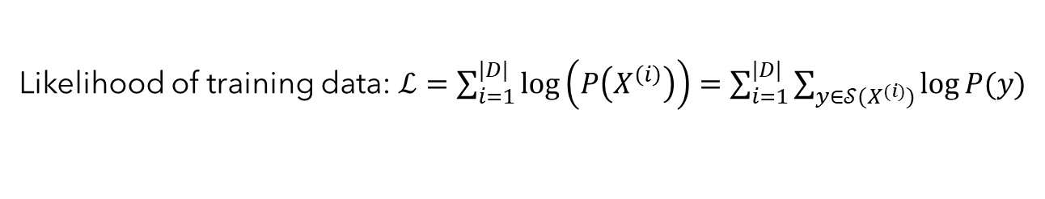
SentencePiece: Unigram Tokenizer
What is the likelihood of the training data $(D)$ given a vocabulary $(𝒱)$?
The Training Data: $D=\{X^{\left(1\right)}, X^{\left(2\right)}, …, X^{(\left|D\right|)}\}$
Segmentation: $𝒮(X)$ conditioned on vocabulary $𝒱$
Likelihood of training data: $ℒ=\sum_{i=1}^{|D|}{\log\left(P\left(X^{\left(i\right)}\right)\right)}=\sum_{i=1}^{|D|}{\sum_{y∈𝒮(X^{(i)})}{\log{P(y)}}}$
To represent the training data better, $ℒ$ has to be maximized
Maximum Likelihood Estimation (MLE) method
What does it mean to maximize?
Maximizing the quantity $P\left(X^{\left(i\right)}\right)$
An element $X$ may have several ways to segment
$𝒱$=["b", "g", "h", "n", "p", "s", "u", "ug", "un", "hug"]
$𝒮\left(\text{hugs}\right)=$ { ["hug", "s"], ["h", "ug", "s"], ["h", "u", "g", "s"]}
Find the segmentation with highest likelihood value

Slide 19
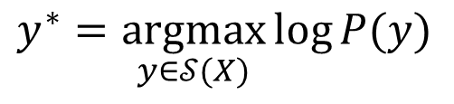
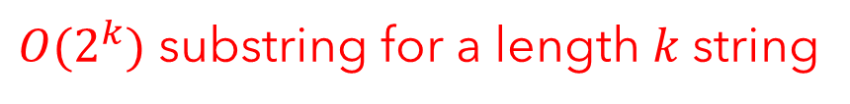
SentencePiece: Unigram Tokenizer
Find the segmentation with highest likelihood value
$$y^{∗}=\underset{y∈𝒮(X)}{argmax}{\log{P(y)}}$$
A naïve approach
Enumerate all possible segmentations
$O(2^{k})$ substring for a length $k$string
Calculate likelihood of each segmentation $y$
Find the segmentation ($y^{∗}$) with maximum likelihood
Viterbi Decoding in rescue
Dynamic programming approach for computing the probability of the most likely sequence out of combinatorically many sequences
https://guillaume-be.github.io/2020-05-30/sentence_piece

Slide 20
Unigram Tokenizer: Viterbi Decoding
Likelihood
=
Likelihood (BestSeg( ))
PREFIX
CHAR
PREFIX
+
Likelihood ( )
CHAR
Viterbi Decoding ensures significant amount of pruning segmentation
options with less likelihood

Slide 21
Unigram Tokenizer: Viterbi Decoding
Token (x) | log(P(x))
b | -5.6
h | -4.8
e | -3.2
j | -6.4
a | -2.9
f | -1.3
r | -6.7
bh | -6.2
bhe | -8.3
ja | -7.5
fr | -5.5
ry | -2.3
y | -2.5
fry | -9.6
b h e j a f r y
Forward pass
Backward pass
-5.6
-5.6-4.8=-10.4
b
h
-6.2
-6.2-3.2=-9.4
-14.7-2.8=-17.5
-8.3-6.4=-14.7
j
a
bh
e
-15.8-1.3=-17.1
-17.1-6.7=-23.8
-8.3
f
r
bhe
-8.3-7.5=-15.8
-15.8-5.5=-21.3
-21.3-2.5=-23.8
ja
fr
y
-15.8-9.6=-25.4
fry

Slide 22
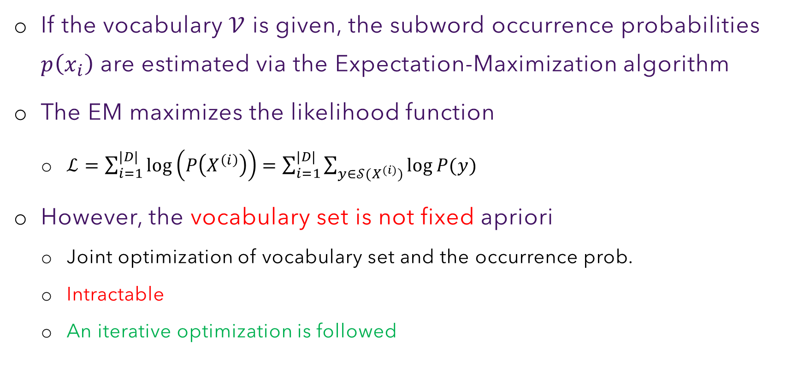
Unigram Tokenizer: Algorithm
If the vocabulary $𝒱$ is given, the subword occurrence probabilities $p\left(x_{i}\right)$ are estimated via the Expectation-Maximization algorithm
The EM maximizes the likelihood function
$ℒ=\sum_{i=1}^{|D|}{\log\left(P\left(X^{\left(i\right)}\right)\right)}=\sum_{i=1}^{|D|}{\sum_{y∈𝒮(X^{(i)})}{\log{P(y)}}}$
However, the vocabulary set is not fixed apriori
Joint optimization of vocabulary set and the occurrence prob.
Intractable
An iterative optimization is followed

Slide 23
Unigram Tokenizer: Algorithm
Expectation-Maximization:
Some observations drawn from an unknown distribution
Start with an initial guess of the parameters of the distribution
[Expectation] Estimate the maximum likelihood (MLE) of the observations
[Maximization] Figure out the model parameters that maximizes the MLE
Initialize a large seeding subword vocabulary from the training corpus
[Expectation] Estimate each subword probability by the corresponding frequency counts in the corpus
[Maximization] Use Viterbi to segment the corpus, returning the optimal segments
Compute the loss of each new subword from optimal segments
Shrink the vocabulary size by dropping the subwords with top X% smallest losses
Repeat step 2 to 5 until the vocabulary size reaches a desired number
Loss of a subword in step 4 is the reduction in overall training corpus segment likelihood if that subword is removed from the current vocabulary.

Slide 24
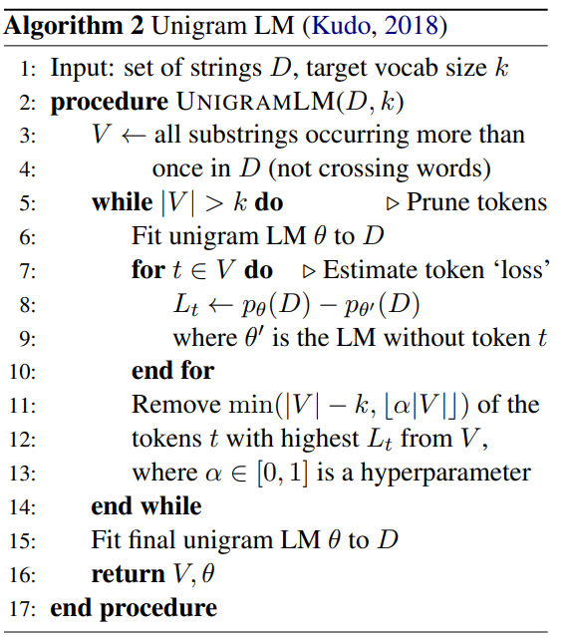
Unigram Tokenizer: Training Algorithm

Slide 25
Unigram Tokenizer: Running Example
Training Corpora
("hug", 10), ("pug", 5), ("pun", 12), ("bun", 4), ("hugs", 5)
Starting Vocabulary (All strict substrings)
["h", "u", "g", "hu", "ug", "p", "pu", "n", "un", "b", "bu", "s", "hug", "gs", "ugs"]
Frequencies of the subwords
("h", 15) ("u", 36) ("g", 20) ("hu", 15) ("ug", 20) ("p", 17) ("pu", 17) ("n", 16)
("un", 16) ("b", 4) ("bu", 4) ("s", 5) ("hug", 15) ("gs", 5) ("ugs", 5)
Optimal segmentation of a given word
"pug“: [‘p’, ‘u’, ‘g’], [‘p’, ‘ug’], [‘pu’, ‘g’]
$$P([^{′}p^{′},^{′}u′, ′g′])=P(′p′)×P(′u′)×P(′g′)=\frac{17}{210}×\frac{36}{210}×\frac{20}{210}=0.00132$$
$$P([^{′}p^{′},′ug′])=P(′p′)×P(′ug′)=\frac{17}{210}×\frac{20}{210}=0.00771$$
$$P([^{′}{pu}^{′},′g′])=P(′pu′)×P(′g′)=\frac{17}{210}×\frac{20}{210}=0.00771$$

Slide 26
Unigram Tokenizer: Running Example
Training Corpora
("hug", 10), ("pug", 5), ("pun", 12), ("bun", 4), ("hugs", 5)
Tokenization of each word
"hug": ["hug"] (score 0.071428)
"pug": ["pu", "g"] (score 0.007710)
"pun": ["pu", "n"] (score 0.006168)
"bun": ["bu", "n"] (score 0.001451)
"hugs": ["hug", "s"] (score 0.001701)
(negative log) Likelihood of the corpus
10 * (-log(0.071428)) + 5 * (-log(0.007710)) + 12 * (-log(0.006168)) + 4 * (-log(0.001451)) + 5 * (-log(0.001701)) = 169.8

Slide 27
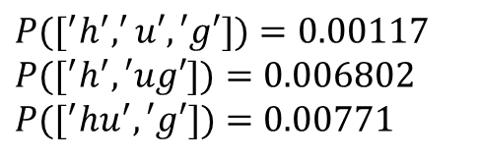
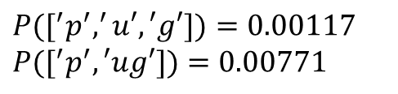
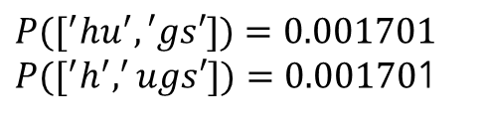
Unigram Tokenizer: Running Example
Compute loss for each subword removal decision
"pug": ["pu", "g"] (score 0.007710)
$P([^{′}p^{′},^{′}u′, ′g′])=0.00117$
$P([^{′}p^{′},′ug′])=0.00771$
Change in likelihood = - 5 * (-log(0.007710)) + 5 * (-log(0.007710)) =0
Removing ‘pu’:
Removing ‘pu’ has no effect
"hug": ["hug"] (score 0.071428)
$P([^{′}h^{′},^{′}u′, ′g′])=0.00117$
$P([^{′}h^{′},′ug′])=0.006802$
$P([^{′}{hu}^{′},′g′])=0.00771$
Removing ‘hug’:
Change in likelihood = -10 * (-log(0.071428))+ 10 * (-log(0.00771))=22.26
"hugs": ["hug", "s"] (score 0.001701)
$P([^{′}{hu}^{′},′gs′])=0.001701$
$P([^{′}h^{′},^{′}ugs′])=0.00170$1
Removing ‘hug’ results in reduction in the likelihood
The token ‘pu’ can be chosen over ‘hug’ for removal as it’s removal has no effect

Slide 28
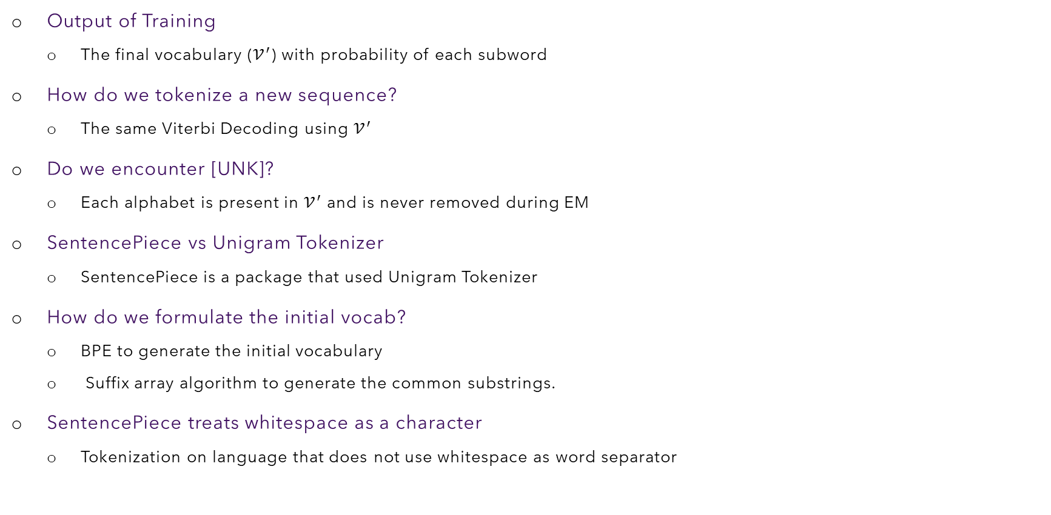
Unigram Tokenizer: Inference
Output of Training
The final vocabulary ($𝒱^{′}$) with probability of each subword
How do we tokenize a new sequence?
The same Viterbi Decoding using $𝒱^{′}$
Do we encounter [UNK]?
Each alphabet is present in $𝒱^{′}$ and is never removed during EM
SentencePiece vs Unigram Tokenizer
SentencePiece is a package that used Unigram Tokenizer
How do we formulate the initial vocab?
BPE to generate the initial vocabulary
Suffix array algorithm to generate the common substrings.
SentencePiece treats whitespace as a character
Tokenization on language that does not use whitespace as word separator

